Slide 1
u5H Obeya
Final readout
May 13, 2026
Ed Sarrat, Alfredo Baratta, Juergen Himmelberg

Slide 2
OBEYA Final Readout Agenda
Obeya mission and outcome
Target Market
Market size, top down / bottom up, OEM heatmap
Key market requirements
Competitive Position
Product Spec: review of technical features and rationale for selection
New IP required
Schedule
Device Price, Cost, and GM% (update ongoing)
Next steps / remaining items

Slide 3
U5Hx Obeya- original Mission
Obeya Mission:
Define a market based U5H family specification with clear competitive differentiation strategy
Obeya Activities:
twice weekly cross-functional team meetings BD, Prod Mktg, Design, Systems Apps, Systems Arch, Strategy
>20 T1 customer meetings for spec input
10 OEM customer meetings for spec input
Obeya Result
Successful in defining U5H Spec with clear competitive differentiation
Continued challenges on cost / GM% and schedule
Mission: Define U5H Product Family Specification
Goal:
Define the U5H family specification by end Q126:
Driven by market input across global OEMs and leading T1s
Clear differentiation strategy vs competition
Target 55% Family Gross Margin (Price vs Cost)
LTV/Total Dev Cost ratio- target of 15:1
Challenges:
Competitive solutions first to market (IFX TC4, ST Stellar, NXP S32K5)
OEM zone adoption plans are dynamic
Internal- fast feedback loop between market needs, price, and cost
Schedule- U5H design start mid 2026, finalize spec by end Q126
Scope:
In Scope: adjustments to memory size/ratio, core selection and performance, features
Out of Scope: process change
Expected Outcome:
U5H Family Specification, confirmed OEM interest, validated featureset, price targets, cost models, business case
Team Members
Role | Name
Project Sponsor | Satoshi Yoshida
Obeya (War Room) PJ Lead | Ed Sarrat
Product Marketing | Juergen Himmelberg
MCU Strategy | Brooke Williams
Global BD Lead | Ed Sarrat
System Applications | Alfredo Baratta
System Architecture | Stefan Singer
Chip Architect | Kshitij Bajaj
Design Lead | Assigned as part of DCP
Business Case Analyst | Tomoki Maesaki

Slide 4
Target Market

Slide 5








Renesas R-Car U5x ARM-based family covering New E/E Architecture
MP
Mass Production
CM
Customer Samples
ES
Early Samples
D
Development
C
Concept
I
Product Idea
Central Computers
High Performance Computers
IVI
GW.
X5x
ADAS,IVI Integration
ADAS
D
Real Time
Central OTA
PT
CS
BD
C5x
I
Centralized Integration (Realtime focus)
Zones & DCU
Physical & Logical
aggregators
DCU
U5H
High End Zones & Domain controllers
BD
BD
BD
C
BD
U5M
Zones / Chassis /
ASIL-D Actuation
D
Smart Actuation
Mission Critical ECUs
Hard real time actuation
U5L
CM
General Purpose / Body /RCP
U5S
C

Slide 6
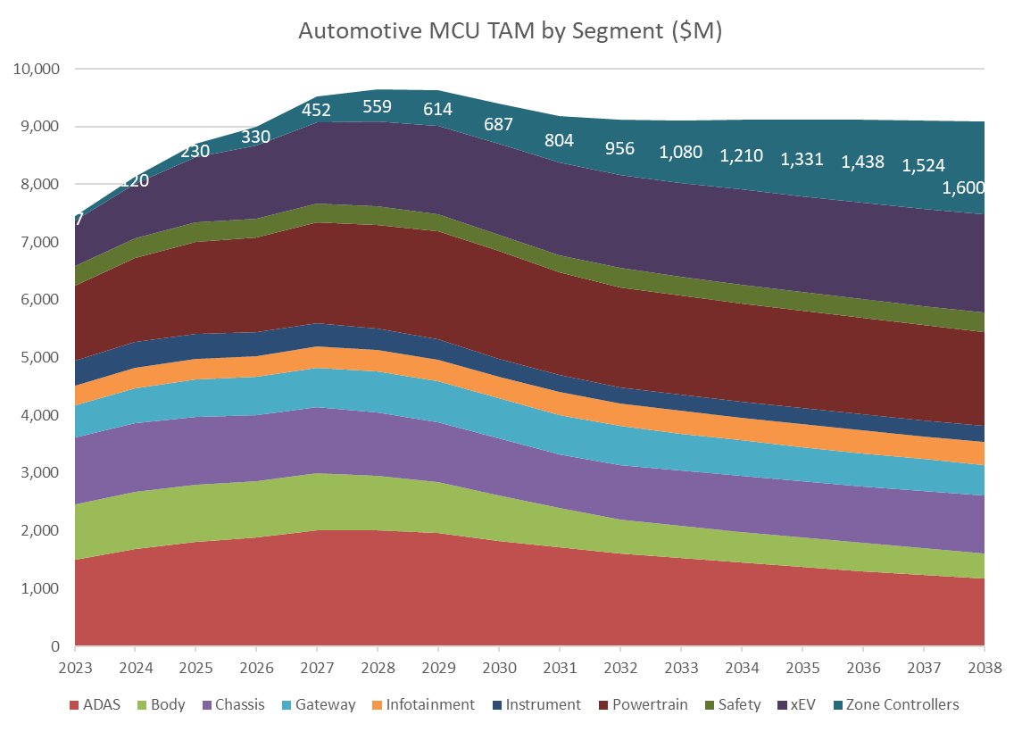
Top-down TAM and LTV analysis
Zone Target Window
Total Zone TAM in window 2027-2037: $11.2B
Estimated Zone sub-segment share:
Low 30% >> 50% U5L, 50% U5H
Mid 15% >> 50% U5M, 50% U5H
High 50% >> 100% U5H
Super High 5% >> 100% C5x
Zone U5H TAM = $8.2B
LTV assuming 30% peak share in 2035: $1.8B
Upside opportunity in Gateway and Central Body/Domain control
Assuming ~$100M investment reqd, $1.8B is strong ROI
Data Source: Golden Market Forecast based on TI data from August 2025, extended by trends

Slide 7
Global Heatmap and Bottom-up SAM
Platform Overview
Active zone control platform evaluation at nearly all OEMs
Adoption across vehicle platforms still tbd- cost challenge
Continued opportunities for domain control where large memory, high performance ARM solution is required
Lead customer engagements in EUR with Volvo and Mercedes, strong interest across U5x at Bosch, Denso
Many OEM program SOP 2030-2032
Need MP ideally 2028, 2029 latest
Bottom Up Market Analysis
U5H Zone TAM = SAM – applicable to all zones
Based on identified programs, estimated SAM ~$4B over 4-5 years, plus platform refresh = ~$8B over 10 years
Aligned with Top Down $8B TAM
U5H Zone Heatmap and Target Programs Apr2026.xlsx
OEM | Region |  | 2026 | 2027 | 2028 | 2029 | 2030 | 2031 | 2032 | 2033 | 2034 | 2035
GM | US |  | Global B |  | SDV2.0 |  |  | SDV3.0
Ford | US | ICE/HYB | FNV3 |  |  | SDV BCM |  |  | SDV Zone |  |  |  |  | Renesas
 |  | EV |  | CE1 |  |  |  |  |  |  |  |  |  | Infineon
Tesla | US |  | Gen5 |  | Gen6 |  |  |  | Gen7 |  |  |  |  | NXP
Rivian | US |  | SDV1.0 |  | SDV1.2 |  |  |  | SDV2.0? |  |  |  |  | TI
Stellantis | EUR |  |  |  |  |  | Atlantis |  |  |  |  |  |  | ST
Mercedes | EUR |  | MBEA-L |  |  |  |  |  | MBEA-C |  |  |  |  | Various
BMW | EUR |  | NEUE Classe- Superbrains + 4xZone |  |  |  |  |  | ? |  |  |  |  | TBD
Renault | EUR |  | PIU |  |  |  |  | ?
Volvo | EUR |  | SPA3 |  |  |  |  | SPA3EVO
 |  |  | SPA2 |  |  | 728BH (SPA2 ECO) IFX+ ??? For Tail Ecu
VW | EUR | ICE/HYB |  |  |  |  | ?
 |  | EV | SDV1.0 |  | SDV1.2 |  |  |  | SDV2.0?
HKMC | KOR |  | XV2 |  |  | XV1
Toyota | JAP |  | BEV 3.0 |  |  |  |  | ?
 |  |  | 19PF V3 |  |  | MPW-ePF |  | K-PF
Honda | JAP |  | MY26 Area ECU |  |  | ? |  |  |  |  |  | for BEV
BYD | CHN |  | ZCU4.0 |  |  | ZCU5.0
XPENG | CHN |  | EEA5.0 |  |  |  | TBD
Changan | CHN |  |  | SDV2.0 |  |  | TBD
Geely | CHN |  | ZCU3.5 |  |  | ZCU4.0
NIO | CHN |  |  | CCC+ZONAL TC399 400MHz |  |  | TBD
Leapmotor | CHN |  |  | Leap3.5 U2A12+S32K3 |  |  | Leap4.0
GWM | CHN |  | Zonal platform |  |  |  | TBD
SAIC | CHN |  | VMC |  |  |  | TBD

Slide 8


Type of Zonal Integration Conceptual view (2029+)
# ADAS, IVI and Drivetrain remain separated
IO Aggregators
(no app control in zones)
“Body”
Integration
Intelligent Zones
“X-Domain”
Integration
HPC
HPC
HPC
ADAS
IVI
ADAS
IVI
ADAS
IVI
Real Time Vehicle Computer
Real Time Vehicle Computer
Real Time Vehicle Computer
100MB /1Gb
100MB
1GB
ETH Ring /
Hybrid Architecture
IO Aggregator
Body Zone Controller
X-Domain Zone Controller
RCP Server
Routing or
Tunneling
RCP Client
Local Body
Apps Control
(ASIL-B)
RCP Server
Routing or
Tunneling
RCP Client
Local Body
Apps Control
(ASIL-B)
Local Apps
Control
(ASIL-D)
RCP Server
Routing or
Tunneling
ADC
PWM
Routing
Tunneling
(CAN/LIN)
ADC
PWM
Routing
…
Tunneling
(CAN/LIN)
ADC
PWM
Routing
Tunneling
(CAN/LIN)
I/O
SPI
ETH
CAN
I/O
SPI
ETH
CAN
I/O
SPI
ETH
CAN
10BT1-S
10BT1-S
SW Less
ECU
Edge ECU
SW Less
ECU
Edge ECU
SW Less
ECU
Edge ECU
Edge ECU
SW Less
ECU
S
Edge ECU
SW Less
ECU
A
S
S
Edge ECU
SW Less
ECU
A
S
A
S
SW Less
ECU
S
A
S
A
S
A
S
S
S
RCP Server
A
S
RCP Server
RCP Server
RCP Server
RCP Server
target
~3 OEMS
~6 OEMS
~6 OEMS
Notes:
What arch is customer using, planning for 2030?
Ask about Audio in zones- AVB vs A2B.

Slide 9
Type of Zonal Integration Conceptual view (2029+)
# ADAS, IVI and Drivetrain remain separated
IO Aggregators
(no app control in zones)
“Body”
Integration
Intelligent Zones
“X-Domain”
Integration
HPC
Key Requirements
Scalable Performance => Up to 10K DMIPS (>=6 Cores)
Up to 24MB NVM
Hypervisor support
Larger SRAM to support ETH Buffers
Up to ASIL-D with Strong QoS and FFI Support => Mainly for x-Domain Zones
Audio PLL & SRC + TDM/I2S for High Res. Sound
Edge AI/ML Support (Predictive Maintenance, Virtual Sensors, Intrusion detections…)
HW Tunneling/Routing
HW MACSec
Low-Power Core
Integrated Switch >= 3 Ports
>350 I/Os & >100 Analog Inputs
Key Requirements
HW Tunneling/Routing
Low-Latency COMMs protocol conversion
HW MACSec
Low-Power Core
Integrated Eth Switch >= 3 ports
>250 I/Os & >100 Analog Inputs
>1Gb ETH (for latency, not bandwidth)
HPC
HPC
ADAS
IVI
ADAS
IVI
ADAS
IVI
Real Time Vehicle Computer
Real Time Vehicle Computer
Real Time Vehicle Computer
100MB /1Gb
100MB
1GB
ETH Ring /
Hybrid Architecture
IO Aggregator
Body Zone Controller
X-Domain Zone Controller
RCP Server
Routing or
Tunneling
RCP Client
Local Body
Apps Control
(ASIL-B)
RCP Server
Routing or
Tunneling
RCP Client
Local Body
Apps Control
(ASIL-B)
Local Apps
Control
(ASIL-D)
RCP Server
Routing or
Tunneling
ADC
PWM
Routing
Tunneling
(CAN/LIN)
ADC
PWM
Routing
…
Tunneling
(CAN/LIN)
ADC
PWM
Routing
Tunneling
(CAN/LIN)
I/O
SPI
ETH
CAN
I/O
SPI
ETH
CAN
I/O
SPI
ETH
CAN
10BT1-S
10BT1-S
SW Less
ECU
Edge ECU
SW Less
ECU
Edge ECU
SW Less
ECU
Edge ECU
Edge ECU
SW Less
ECU
S
Edge ECU
SW Less
ECU
A
S
S
Edge ECU
SW Less
ECU
A
S
A
S
SW Less
ECU
S
A
S
A
S
A
S
S
S
RCP Server
A
S
RCP Server
RCP Server
RCP Server
RCP Server
target
~3 OEMS
~6 OEMS
~6 OEMS
Notes:
What arch is customer using, planning for 2030?
Ask about Audio in zones- AVB vs A2B.

Slide 10
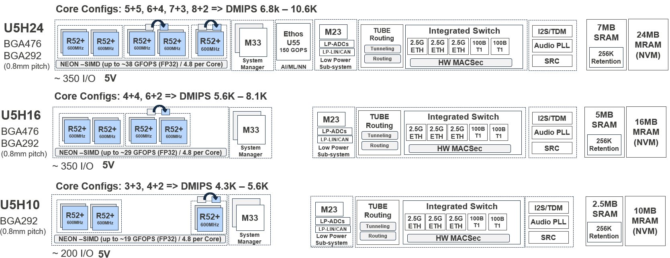
R-Car U5H Family
U5H delivers Best‑in‑class perf, connectivity, and system efficiency — minimizes SW complexity
Target Applications
Zone Controllers
IO Aggregators
Domain Controllers
Central Body Controllers & Gateway
Key Features
ARM Cortex-R52+ up to (5+5 -> 8+2) @ 600MHz
Edge AI Support: Up to 38 GFOPS (SIMD) + 150 GOPS (U55)
NVM: 10-24 MB Flash / up to 7 MB RAM
3 x 2.5 Gb Eth Switch, 10BT1S, CAN FD/XL
Routing & Tunneling Accelerators (TUBE)
Security: EVITA Full, ISO21434, HW MACSec , SecOC
Safety: ISO26262 up to ASIL-D
Pin Packages: BGA292 and BGA476
Benefits
🔹High Performance with Split-lock Flexibly, FFI & QoS:
R52+ w/ Hypervisor support
🔹Built for Future E/E Networking:
2.5Gb ETH, switch, MACSec, HW IEEE1722 tunneling, lower latency comms
🔹MRAM = Faster, Safer, Lower Power
Higher endurance, Faster updates, Better power efficiency
🔹Reduce BOM & External ICs
High I/O count, 5V Support, Built‑in switch, Fewer expanders, fewer PHYs

Slide 11
Competitive position

Slide 12




U5H Family The most balanced high-performance zone controller mcu
U5H delivers Best‑in‑class perf, connectivity, and system efficiency — without SW complexity
 |  |  |  |  | Notes
Performance | ✅ | ◻ | ◻ | ✅ | U5H24 => 10K, SR6G7 => 5K, S32K5 => 11K, TC4Z => 6,5K
Core homogeneity | ✅ | ✅ | ✅ | ❌ | S32K5 => R52 & M7 mix
Edge AI Accelerators | ✅ | ⚠️ | ❌ | ✅ | U5H24 => 38 GFOPS + 150 GOPS (U55); TC4x => PPU N/A on ZC; SR6G => DFA
Flexible core configs | ✅ | ◻ | ❌ | ◻ | To cover more SW Architectures / Application with same silicon
Integrated switch | ✅ | ✅ | ❌ | ✅ | >= $2 BOM savings
2.5Gb Ethernet | ✅ | ❌ | ⚠️ | ✅ | TC4x has up to 5Gb, but no switch, so Cores cannot “Consume” > 1GB Traffic
HW IEEE1722 tunneling | ✅ | ❌ | ✅ | ❌ | HW Solution offers lower latency possible for CAN/LIN Tunneling over ETH
Low latency COMMs | ✅ | ❌ | ❌ | ❌ | Nobody has a system like TUBE to support low-latency COMMs
Audio PLL & SRC | ✅ | ✅ | ✅ | ❌ | ~ $1 BOM savings
5V I/O + ADC | ✅ | ◻ | ✅ | ❌ | For legacy sensors reusage with minimum costs
🔹 High Performance, Simplified Architecture
High core count with split lock flexibility for Application partitioning
Support Hypervisor
More SRAM to support Message buffers
🔹Built for Zonal Networking
3x 2.5Gb + 2x 10BT1S w/ integrated switch
HW MACSec
HW IEEE1722 tunneling
Lower latency communications (TUBE)
Low power subsystem
🔹 MRAM = Faster, Safer, Lower Power
Higher endurance
Faster OTA updates
Better power efficiency
🔹Reduce BOM & External ICs
High I/O count
5V Support
Built‑in switch (-$2)
Audio PLL + SRC (-$1)

Slide 13
Product spec - Rationale

Slide 14
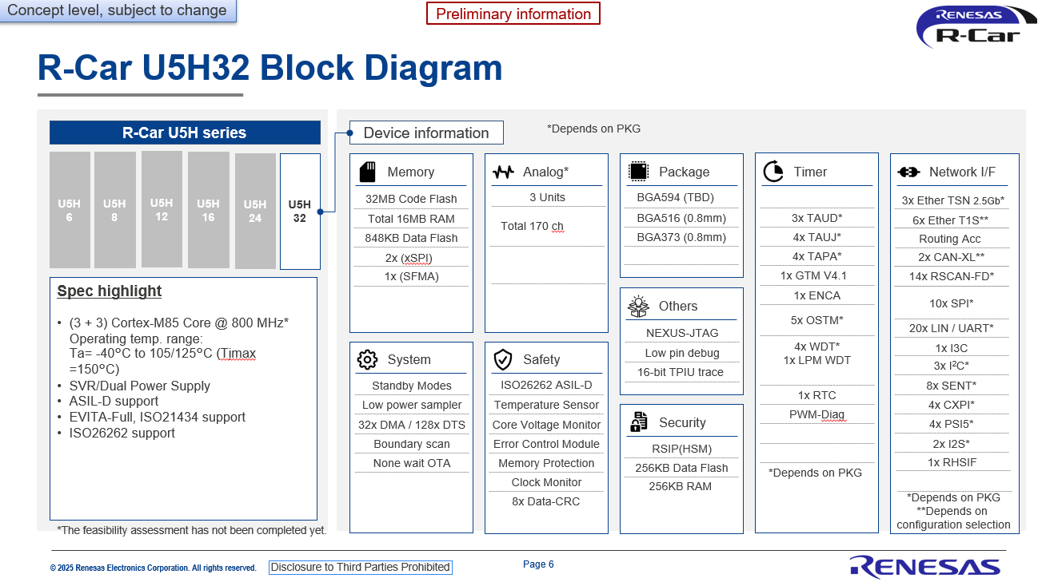
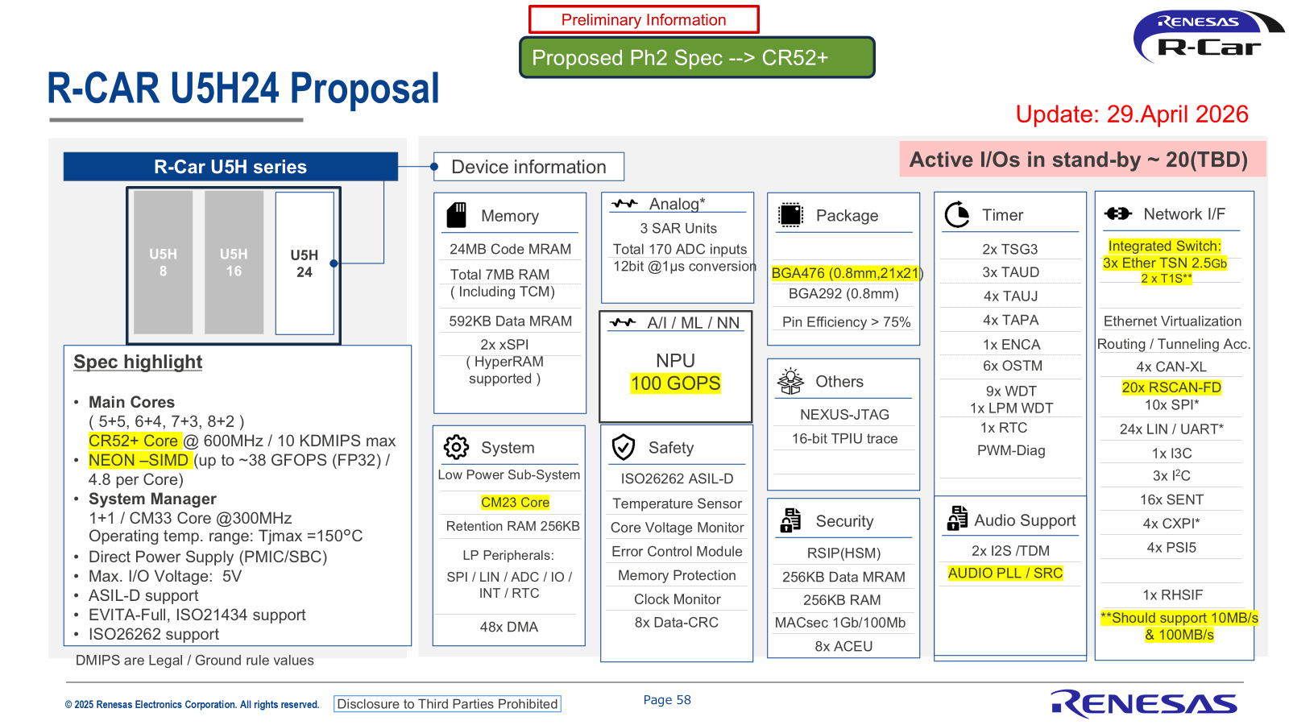
U5H - Before/After Obeya spec
3 Cores (3+3, no split-lock, no COMMs offloading) => Up to 8 + 1 Cores (Higher Flexibility to cover different SW architectures)
No Hypervisor supported => Hypervisor supported to enable multi-applications on same core with FFI
No LP Core & Peripherals => LP Core + CAN/LIN to manage inside same MCU more advanced low power tasks
No Edge AI Support => Math Acceleration (SIMD) for AI/ML
No embedded Switch => Integrated switch to enable up to $2 BOM Savings
No Audio PLL & Sample Rate Conv. (SRC) => Audio PLL & SRC to enable BOM savings ~$1
GTM => No GTM (not needed => less costs)
1:2 SRAM/NVM => 1:3,75 SRAM/NVM => Better costs and lower leakage, no Flip Chip
BGA516 (25x25) => BGA476 Better costs (21x21), similar number of I/Os
No System Manager Core => Added System Manager Core (improved FFI, COMMs offloading)

Slide 15
U5H Family Concept- Obeya Updates
Core Configs: 5+5, 6+4, 7+3, 8+2 => DMIPS 6.8k – 10.6K
U5H24
System Manager
AI/ML/NN
Low Power
Sub-system
7MB
SRAM
24MB
MRAM
(NVM)
M33
MHz
Ethos
U55
150 GOPS
Low Power
Sub-system
TUBE
Routing
Integrated Switch
M23
I2S/TDM
BGA476 BGA292
(0.8mm pitch)
R52+
600MHz
R52+
600MHz
R52+
600MHz
R52+
600MHz
R52+
600MHz
M33
M23
LP-ADCs
2.5G ETH
2.5G ETH
2.5G ETH
100B
T1
100B
T1
Audio PLL
ADCs
Tunneling
256K Retention
LP-LIN/CAN
Routing
SRC
NEON –SIMD (up to ~38 GFOPS (FP32) / 4.8 per Core)
HW MACSec
~ 350 I/O
5V
Core Configs: 4+4, 6+2 => DMIPS 5.6K – 8.1K
U5H16
System Manager
Low Power
Sub-system
5MB
SRAM
16MB
MRAM
(NVM)
M33
MHz
Low Power
Sub-system
TUBE
Routing
Integrated Switch
M23
I2S/TDM
BGA476 BGA292
(0.8mm pitch)
R52+
600MHz
R52+
600MHz
R52+
600MHz
R52+
600MHz
M33
M23
LP-ADCs
Tunneling
2.5G ETH
2.5G ETH
2.5G ETH
100B
T1
100B
T1
Audio PLL
ADCs
256K Retention
LP-LIN/CAN
Routing
SRC
NEON –SIMD (up to ~29 GFOPS (FP32) / 4.8 per Core)
HW MACSec
~ 350 I/O
5V
Core Configs: 3+3, 4+2 => DMIPS 4.3K – 5.6K
U5H10
System Manager
Low Power
Sub-system
2.5MB
SRAM
10MB
MRAM
(NVM)
M33
MHz
Low Power
Sub-system
TUBE
Routing
Integrated Switch
I2S/TDM
M33
M23
BGA292 (0.8mm pitch)
R52+
600MHz
R52+
600MHz
R52+
600MHz
M23
LP-ADCs
2.5G ETH
2.5G ETH
2.5G ETH
100B
T1
100B
T1
Audio PLL
ADCs
Tunneling
256K Retention
LP-LIN/CAN
Routing
SRC
NEON –SIMD (up to ~19 GFOPS (FP32) / 4.8 per Core)
HW MACSec
~ 200 I/O
5V

Slide 16
U5H Family Concept-Rationale
1
2
3
4
5
R52+ Core
Modern ARM core / high perf
Hypervisor support
Flexible core config for perf or safety
NEON-SIMD for Vector Math Acceleration
System Manager
Configures and manages protection mechanisms to ensure Freedom From Interference
Offloads CPUs from COMMs SW Stack
Low Power Subsystem
Enable low power standby operation with access to key peripherals
Integrated Switch
Required in zones, external cost ~$2+, minimal cost to integrate
Memories
>4:1 NVM/SRAM ratio
Large retention RAM
Core Configs: 5+5, 6+4, 7+3, 8+2 => DMIPS 6.8k – 10.6K
U5H24
System Manager
AI/ML/NN
Low Power
Sub-system
7MB
SRAM
24MB
MRAM
(NVM)
M33
MHz
Ethos
U55
150 GOPS
Low Power
Sub-system
TUBE
Routing
Integrated Switch
M23
I2S/TDM
BGA476 BGA292
(0.8mm pitch)
R52+
600MHz
R52+
600MHz
R52+
600MHz
R52+
600MHz
R52+
600MHz
M33
M23
LP-ADCs
2.5G ETH
2.5G ETH
2.5G ETH
100B
T1
100B
T1
Audio PLL
ADCs
Tunneling
256K Retention
LP-LIN/CAN
Routing
SRC
NEON –SIMD (up to ~38 GFOPS (FP32) / 4.8 per Core)
HW MACSec
~ 350 I/O
5V
9
8
7
6
IO
High IO count for zones in cost optimized 476BGA
5V IO support demanded by Japan, some interest in AMR
AI/ML/NN
Integrated accelerator to support next gen edge AI
Target use cases:
MPC, ML, Predictive Maintenance, Virtual Sensors, Intrusion detection…
TUBE
Routing accelerator for low-latency communication from end node to central compute
Tunneling in HW for fastest ETH-CAN conversion
Audio PLL and SRC
Common use case for Audio in zones
Requires PLL, external cost ~$1, low cost to integrate, competition supports

Slide 17
NEW IP REquired

Slide 18
New IP required for U5H
Detailed requirements
U5H_MRD_Inputs.pptx
New Devt Reqd
DCLS Cortex-M33 as Partition / System Manager
Low Power Subsystem with Cortex-M23 core
Routing Accelerator (TUBE)
Audio PLL with Sample Rate Converters
BGA476 – new package
Partially Available
New Platform Subsystem for Cortex R52+ cores
Memory Subsystem
AI subsystem using ARM Ethos U55
OC-SGMII SERDES to support 2.5 Gbps
RSWITCH 3.1 subsystem for integrated Ethernet switch
I2S / TDM16
Debug IP for CR52+ / CM33 / CM23 / CM0+
Optional- continued evaluation
3.3 V max I/O library, 3.3 V ADC- if needed for cost reduction ( Technology development )
External ADC interface (DS-ADC I/F)

Slide 19
SChedule

Slide 20
U5H High Level Schedule
Products | CY26-1H |  |  |  |  |  | CY26-2H |  |  |  |  |  | CY27-1H |  |  |  |  |  | CY27-2H |  |  |  |  |  | CY28-1H |  |  |  |  |  | CY28-2H |  |  |  |  |  | CY29-1H |  |  |  |  |  | CY29-2H |  |  |  |  |  | CY30-1H
 | 1 | 2 | 3 | 4 | 5 | 6 | 7 | 8 | 9 | 10 | 11 | 12 | 1 | 2 | 3 | 4 | 5 | 6 | 7 | 8 | 9 | 10 | 11 | 12 | 1 | 2 | 3 | 4 | 5 | 6 | 7 | 8 | 9 | 10 | 11 | 12 | 1 | 2 | 3 | 4 | 5 | 6 | 7 | 8 | 9 | 10 | 11 | 12 | 1 | 2 | 3 | 4 | 5 | 6
TO
WS
ES
CS
MP
IP dev start
IP Dev Complete
12 months from IP dev
U5H24
U5H16
GF collaterals Short-term
release
U5H10
GF collaterals Mid-term B
release
Schedule Summary:
Current view: WS early 2029, MP early 2030 -> OEM SOP2032+ (misses lead OEM programs)
Opportunities to accelerate:
IP dev start in 2026 with priority over U3B
Parallelized SOC and IP devt
Target schedule- WS 2028, MP 2029 -> support OEM SOP 2031+
We are here

Slide 21
Pricing / Device cost / GM%

Slide 22
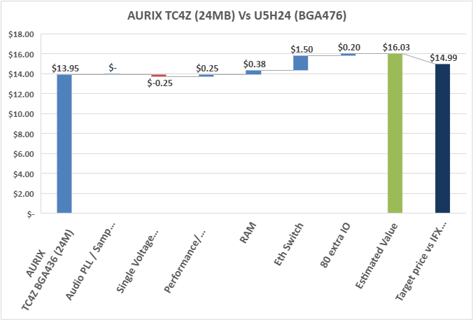
Competitive market pricing analysis Economic Value Estimation (EVE)
Step | Value | Take Rate | BOM Value | Notes
AURIX TC4Z BGA436 (24M) | $13.95 | 90% | $15.50 | 2028 price, degraded 10% for 2032
Audio PLL / Samp Rt Conv | $- |  | $- | Now supported
Single Voltage Supply | $-0.25 | 50% | $-0.50 | EVR on TC4Z reqs only 5V, not 3.3+5
Performance/ Flexibility | $0.25 | 50% | $0.50 | 6+6 Tricore at 500Mhz (no splitlock) vs 5+5 R52 at 600Mhz- similar ASIL-D DMIPs- advantage to REN in flexibility
RAM | $0.38 | 75% | $0.50 | 1M adtl SRAM (8M vs 7M)
Eth Switch | $1.50 | 75% | $2.00 | No Switch on TC4z
80 extra IO | $0.20 | 50% | $0.40 | 436 pin package vs 516 BGA
Estimated Value | $16.03
Target price vs IFX (Shared value to overcome switching costs) | $14.99
Same pricing methodology applied across major competitors for each device U5H24/16/10
Economic_Valuation_Estimation_U5H.xlsx

Slide 23
Price/Cost/Margin Estimates
Revised cost model delivered 14MAY – rev 11
cogs_U5Hx_for_internal_case_study_r11.xlsx
GM% Estimates
Rev 11 Cost Model GM Est 14May2026
 | EVE Mkt pricing ~2032 (yen) | GM % (Rev 11 Cost)
U5H24_476 | 1500 | 47.0%
U5H24_292 | 1350 | 44.1%
U5H16_476 | 1050 | 36.2%
U5H16_292 | 900 | 30.3%
U5H10_476 | NA | NA
U5H10_292 | 700 | 35.3%

Slide 24
Next steps / remaining challenges

Slide 25
U5H Next steps / remaining challenges
Technical
Conclude on GF 22FDX
Assess impact of Neon and Ethos U55 integration on cost/power
Confirm Wirebond BGA Feasibility = no FC Package
Audio PLL + SRC integration
Product Family
Continue evaluation of family extensions: <10M for low end IO Aggregators, >24M for large domain controllers
Higher pin count option at 10M
Consider 32M with additional SRAM (12M) for ADAS SOC Level 3+ interface MCU –12M (Nvidia)
Evaluation of XEV Extension (Inverter/BMS supported, extension for DC-DC/OBC)
Decision on RISC-V adoption
Pre-silicon VDK offering – requires initial version of Target Specification (TS)
Cost/Schedule
Cost optimization
Schedule acceleration
Customer engagement
Promote updated spec solicit final inputs before DCP
Must share updated target schedule

Slide 26
Action Items captured
Deliver spec table to design team to enable schedule estimation by end of May prior to Strategy Meeting 8JUN (Juergen)
Design team to communicate input needed to build estimated schedule (Abhijeet)
Engage IP team for schedule input- deliver SRD completion schedule (Srikar)
Aim to enable priority discussion at Strategy meeting

Slide 27
R-Car U5H Family
U5H delivers Best‑in‑class perf, connectivity, and system efficiency — minimizes SW complexity
Target Applications
Zone Controllers
IO Aggregators
Domain Controllers
Central Body Controllers & Gateway
Key Features
ARM Cortex-R52+ up to (5+5 -> 8+2) @ 600MHz
Edge AI Support: Up to 38 GFOPS (SIMD) + 150 GOPS (U55)
NVM: 10-24 MB Flash / up to 7 MB RAM
3 x 2.5 Gb Eth Switch, 10BT1S, CAN FD/XL
Routing & Tunneling Accelerators (TUBE)
Security: EVITA Full, ISO21434, HW MACSec , SecOC
Safety: ISO26262 up to ASIL-D
Pin Packages: BGA292 and BGA476
Benefits
🔹High Performance with Split-lock Flexibly, FFI & QoS:
R52+ w/ Hypervisor support
🔹Built for Future E/E Networking:
2.5Gb ETH, switch, MACSec, HW IEEE1722 tunneling, lower latency comms
🔹MRAM = Faster, Safer, Lower Power
Higher endurance, Faster updates, Better power efficiency
🔹Reduce BOM & External ICs
High I/O count, 5V Support, Built‑in switch, Fewer expanders, fewer PHYs

Slide 28
Thank you

